Slide 1
YARN

Slide 2
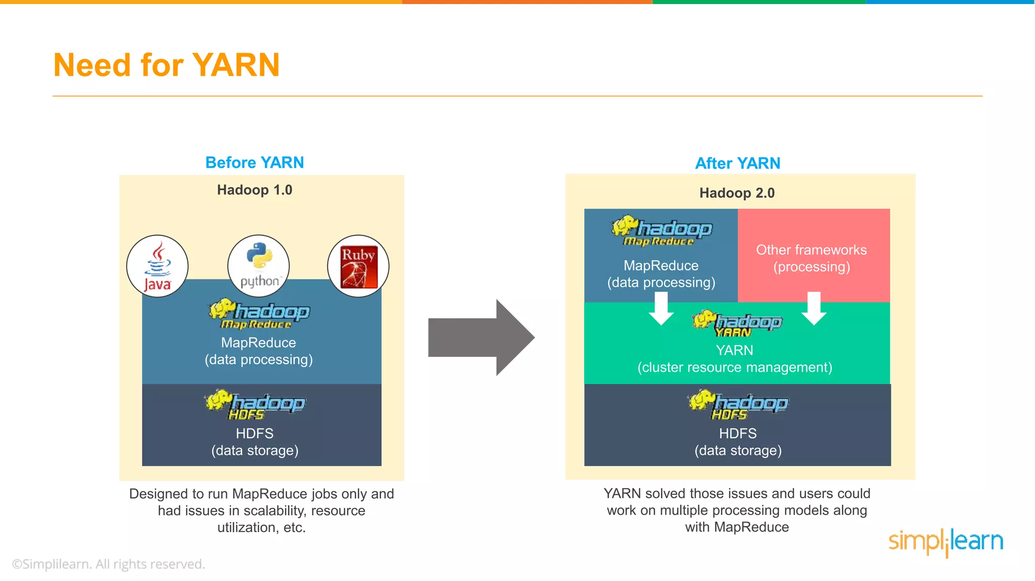

Slide 3
Challenges
Map-Reduce isn’t the best match for all the problems. It’s good for simple elementary requests and problems that can be divided into independent units, but it’s not efficient for frequent analytic tasks.
Entry-level programmers may find it difficult to be productive with Map-Reduce.
Data Security is also an issue in Hadoop, though with new tools around like Kerberos authentication protocol is a great step forward in making Hadoop secure than before.

Slide 4
YARN
Hadoop YARN is a specific component of the open source Hadoop platform for big data analytics.
YARN stands for “Yet Another Resource Negotiator”. YARN was introduced to make the most out of HDFS.
Job scheduling is also handled by YARN.

Slide 5
Yarn
● YARN(Yet Another Resource Negotiator) is cluster resource management system for Hadoop.
● YARN was introduced in Hadoop 2 to improve the MapReduce implementation and eliminate Hadoop 1 scheduling disadvantages.
● YARN is a connecting link between high level applications(Spark,HBase e.t.c) and low level Hadoop environment.
● With introduction of YARN, Hadoop transformed from only MapReduce framework to big data processing core.
● Some people characterized YARN as a large-scale, distributed operating system for big data applications.

Slide 6
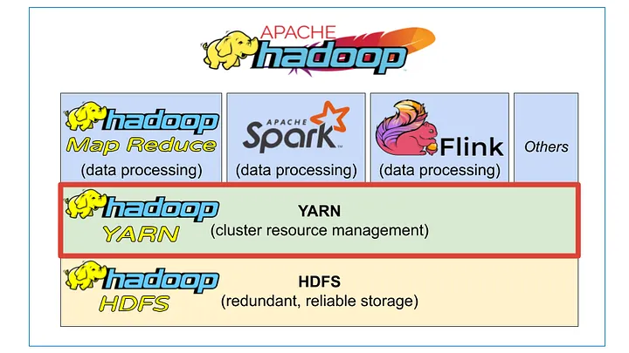

Slide 7
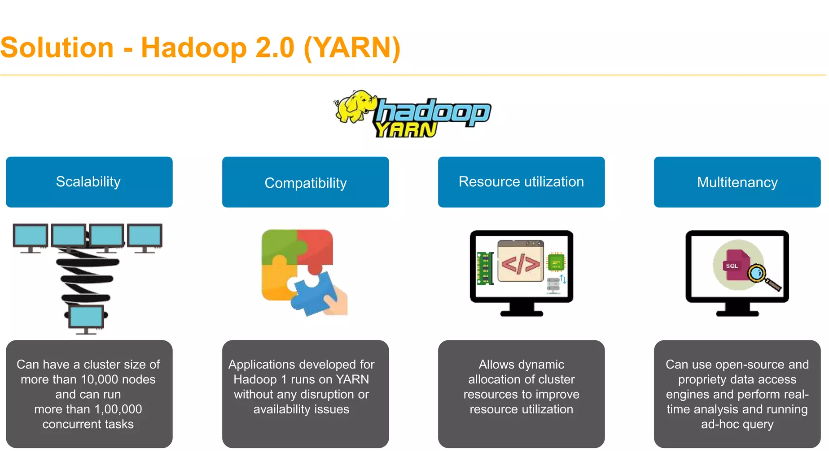

Slide 8
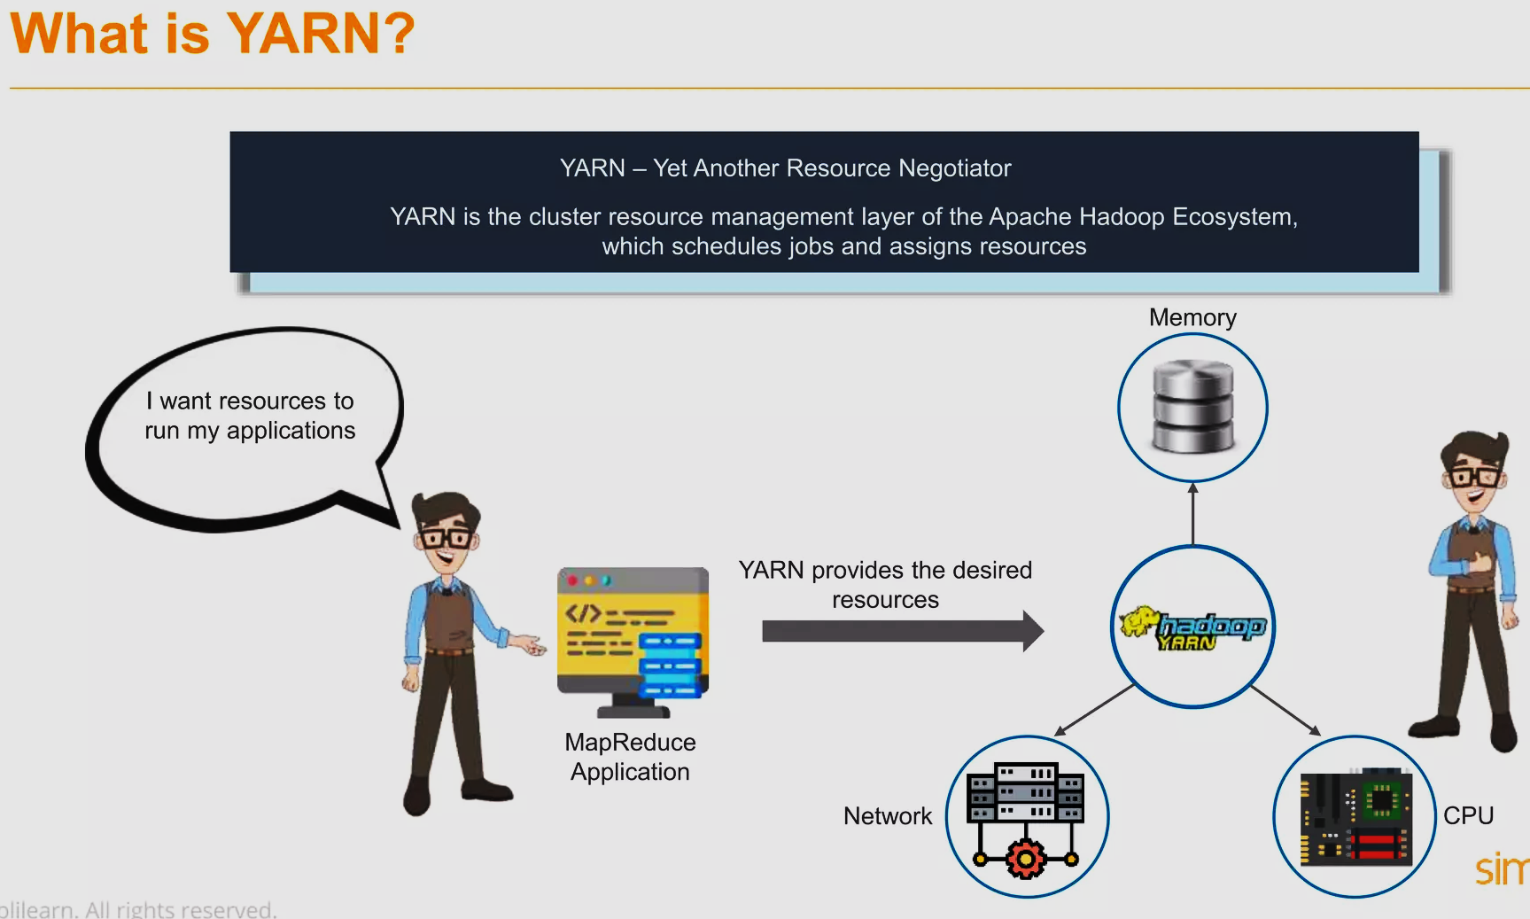

Slide 9
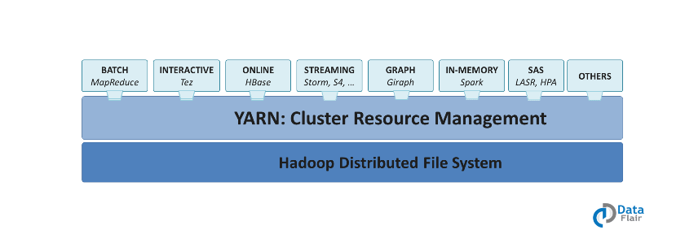
Yarn extends the power of Hadoop to other evolving technologies, so they can take the advantages of HDFS and economic cluster.
YARN allows the data stored in HDFS to be processed and run by various data processing engines such as batch processing, stream processing, interactive processing, graph processing and many more. Thus the efficiency of the system is increased with the use of YARN
It provides independent software vendors and developers a consistent framework for writing data access applications that run in Hadoop.

Slide 10
Hadoop 1.0 | Hadoop 2.0
- Limited up to 4000 nodes per cluster - Only has one namespace for managing HDFS - Map and Reduce slots are static - Running job is only MapReduce | Potentially up to 10000 nodes per cluster - Supports multiple namespaces for managing HDFS - Efficient cluster utilization (YARN) - Any app can integrate with Hadoop
Namespace we mean a certain location on the hdfs.
In Hadoop we refer to a Namespace as a file or directory which is handled by the Name Node.
According to Hadoop, Name Node manages the file system namespace.
It maintains the file system tree, and the metadata of all the files and the directories in the tree.

Slide 11
MapReduce vs Yarn
comparison | YARN | Map Reduce
Meaning | YARN Stands for Yet Another Resource Negotiator. | Map Reduce is self-defined.
Version | Introduce in Hadoop 2.0 | Introduce in Hadoop 1.0
Responsibility | Now YARN is responsible for Resource management part. | Earlier Map reduce was responsible for Resource Management as well as data processing
Execution model | Yarn execution model is more generic as compare to Map reduce | Less Generic as compare to YARN.
Architecture | YARN is introduced in MR2 on top of job tracker and task tracker. In the place of job tracker and task tracker Application, the master comes into the picture. | In the earlier version of MR1, YARN is not there In the place of YARN job tracker and task tracker was present which help in the execution of application or jobs
Flexibility | YARN is more isolated and scalable | Less scalable as compare to YARN.

Slide 12
Daemons | YARN has Name Node, Data node, secondary Name node, Resource Manager and Node Manager. | Map Reduce has Name node, Data node, Secondary Name node, job tracker and task tracker.
Limitation | There is no concept of single point of failure in YARN because it has multiple Masters so if one got failed another master will pick it up and resume the execution. | Single point of failure, low resource utilization(Max of 4200 clusters by YAHOO) and less scalability when compare to YARN
Size | By default the size of a data node in YARN is 128MB | By default the size of a data node in Map reduce is 64MB.
YARN is a generic job scheduling framework and HDFS is a storage framework.

Slide 13
Hadoop 2 has a lots of high level applications that was written on top of the Yarn, by using Yarn API’s for example Spark,HBase e.t.c. MapReduce have also become an application on top of the Yarn.
Yarn and its applications concept brings flexibility and a lots of new opportunities for Hadoop environment.

Slide 14
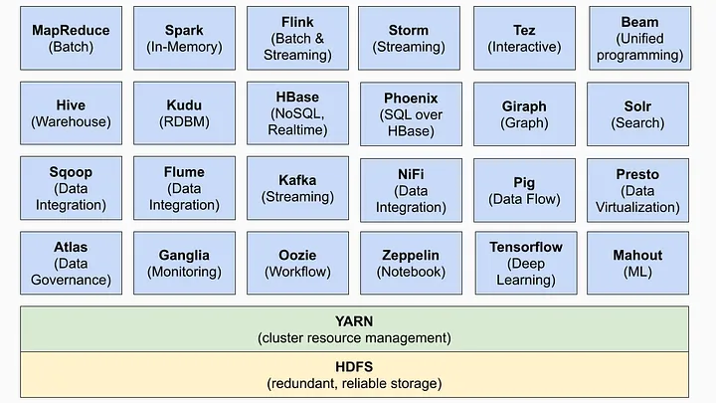
Applications that run on YARN
Apache yarn is also a data operating system for Hadoop 2.x.

Slide 15
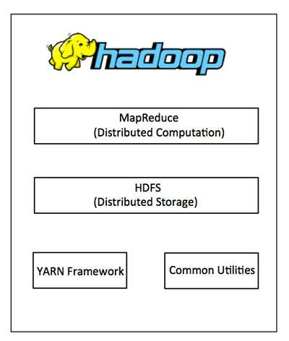
Yarn
YARN is the prerequisite for Enterprise Hadoop
providing resource management and a central platform to deliver consistent operations, security, and data governance tools across Hadoop clusters.

Slide 16
The Core Apache Hadoop Project
Hadoop Common:
Java libraries and utilities required by other Hadoop modules.
Hadoop YARN:
a framework for job scheduling and cluster resource management.
HDFS:
A distributed file system
Hadoop MapReduce:
YARN-based system for parallel processing of large data sets.

Slide 17
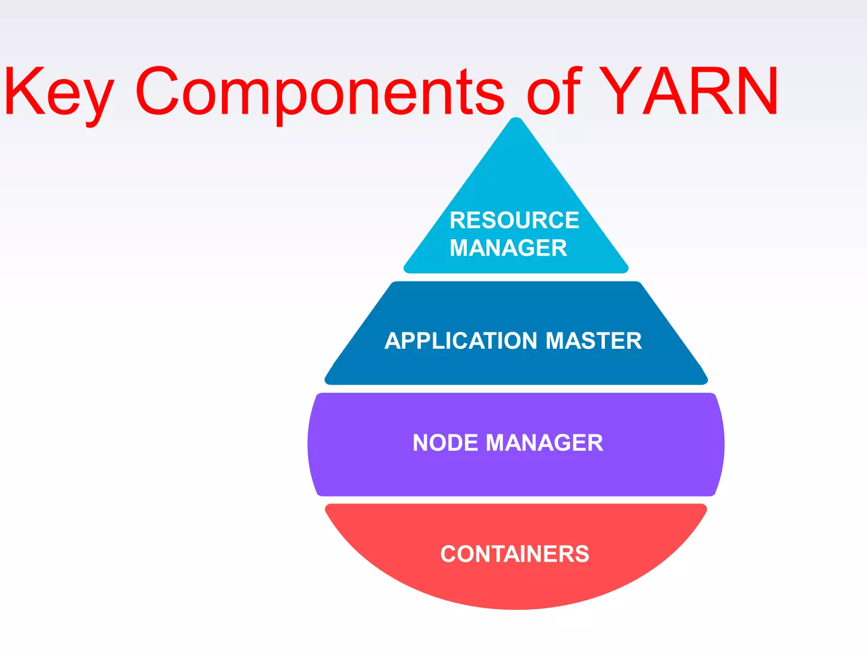

Slide 18
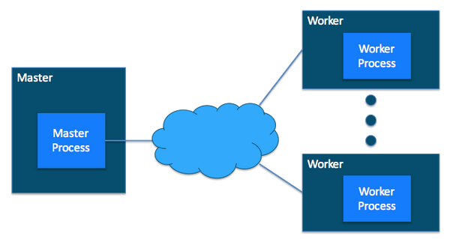
Cluster
In Hadoop, a computer is known as a Host and in YARN the same is denoted as a Node. Hence, two or more Hosts, connected by a local high-speed network creates a cluster. From the viewpoint of Hadoop, there may be several thousand hosts in a cluster.
Host can be divided into two parts, Master and Worker. Master Host-only communicates with the client and sends the work to the rest of the cluster in which all the worker hosts are.

Slide 19
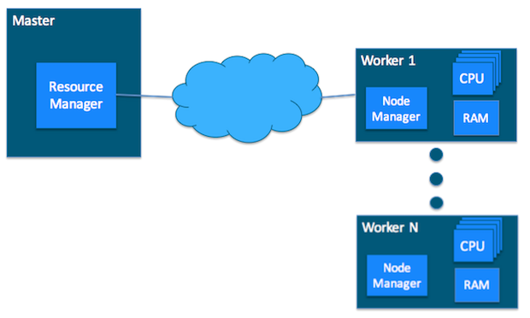
YARN Cluster Basics
In a YARN cluster, there are two types of hosts:
The ResourceManager is the master daemon that communicates with the client, tracks resources on the cluster, and orchestrates work by assigning tasks to NodeManagers.
A NodeManager is a worker daemon that launches and tracks processes spawned on worker hosts.

Slide 20
V core
Virtual cores (vcores) are a way for YARN to manage CPU resources. A vcore is a share of the host CPU that the YARN Node Manager allocates to available resources. A node's capacity should be configured with virtual cores equal to its number of physical cores

Slide 21
Yarn Resource Monitoring
YARN currently defines two resources:
v-cores
memory.
Each NodeManager tracks
its own local resources and
communicates its resource configuration to the ResourceManager
The ResourceManager keeps
a running total of the cluster’s available resources.

Slide 22
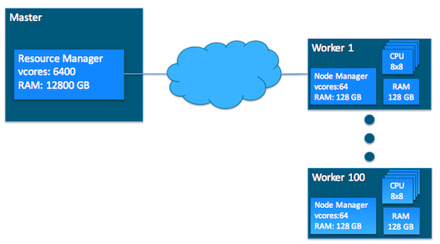
Yarn Resource Monitoring
100 workers of same resources

Slide 23
Container
A container is a unit of resource allocation, an abstraction representing on a specific worker node in a Hadoop cluster.
Containers are assigned to execute tasks from applications, such as MapReduce jobs or Spark tasks.
Each container has a specific amount of resources allocated to it, such as CPU, memory, and disk space, allowing the task to run in a controlled and isolated environment.

Slide 24
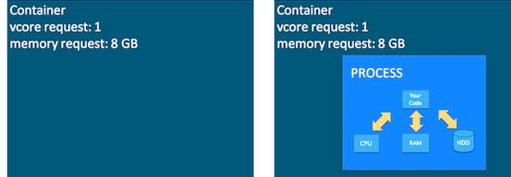
Yarn Container
Containers
a request to hold resources on the YARN cluster.
a container hold request consists of vcore and memory
The task running as a process inside a container
Container as a hold

Slide 25
Yarn Application and ApplicationMaster
Yarn application
It is a YARN client program that is made up of one or more tasks
Example: MapReduce Application
ApplicationMaster
It helps coordinate tasks on the YARN cluster for each running application
It is the first process run after the application starts.

Slide 26
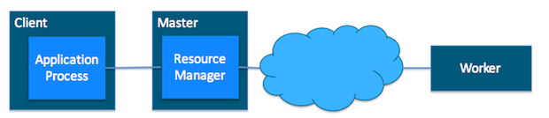
Interactions among Yarn Components (i)
1. The application starts and talks to the ResourceManager for the cluster

Slide 27
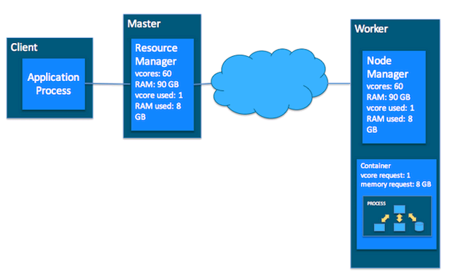
Interactions among Yarn Components
2. The ResourceManager makes a single container request on behalf of the application

Slide 28

Interactions among Yarn Components (iii)
3. The ApplicationMaster starts running within that container

Slide 29
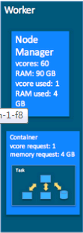
Interactions among Yarn Components
4. The ApplicationMaster requests subsequent containers from the ResourceManager that are allocated to run tasks for the application. Those tasks do most of the status communication with the ApplicationMaster allocated in Step 3

Slide 30
Interactions among Yarn Components (v)
5. Once all tasks are finished, the ApplicationMaster exits. The last container is de-allocated from the cluster.
6. The application client exits

Slide 31
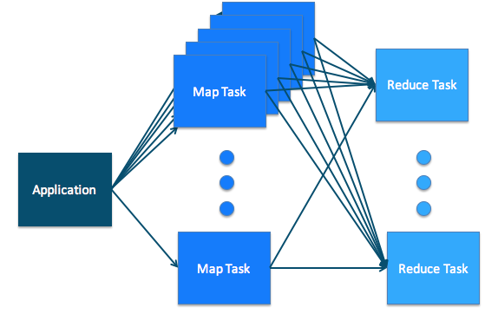
MapReduce on Yarn
In the MapReduce paradigm, an application consists of Map tasks and Reduce tasks.
Map tasks and Reduce tasks align very cleanly with YARN tasks.

Slide 32
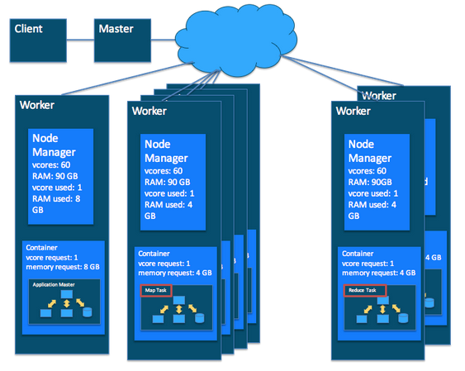
Putting it Together: MapReduce and YARN
In a MapReduce application
there are multiple map/reduce tasks
each task runs in a container on a worker host in the cluster
On the YARN side
the ResourceManager, NodeManager, and ApplicationMaster work together to manage the cluster’s resources

Slide 33
Scheduling in Yarn
A cluster scheduler essentially has to address:
Multi-tenancy: On a cluster, many users launch many different applications, on behalf of multiple organizations. A cluster scheduler allows varying workloads to run simultaneously.
Scalability: A cluster scheduler needs to scale to large clusters running many applications.
YARN uses queues to share resources among multiple tenants.
The ApplicationMaster (AM) tracks each task’s resource requirements and coordinates container requests
The RM/scheduler doesn’t need to track all containers running on the cluster.

Slide 34
Scheduling in YARN
The ResourceManager (RM) tracks resources on a cluster, and assigns them to applications that need them.
The scheduler is that part of the RM that does this matching honoring organizational policies on sharing resources.

Slide 35
Yarn Queues for Scheduling
Queues are the organizing structure for YARN schedulers, allowing multiple tenants to share the cluster.
As applications are submitted to YARN, they are assigned to a queue by the scheduler.
The Yarn queues are hierarchical queues
The root queue is the parent of all queues. All other queues are each a child of the root queue or another queue

Slide 36
YARN Architecture and its Components
The three important elements of the YARN architecture are:
Resource Manager (RM)
Application Master (AM)
Node Managers (NM)

Slide 37
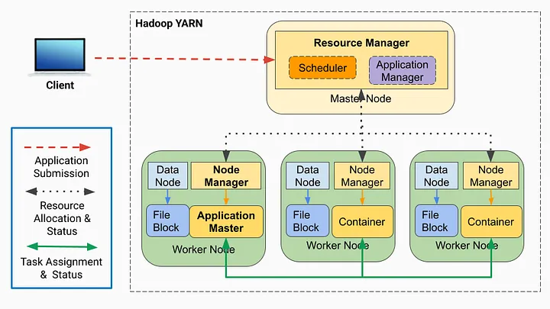
Hadoop YARN Architecture

Slide 38
Resource Manager (RM)
The Resource Manager is a Java process running on the master node that is responsible for managing and allocating resources such as CPU, memory, and disk across the Hadoop cluster based on the needs of various jobs.
Cluster resource tracking: It maintains a global view of the cluster and tracks the available resources on each node.
Cluster health monitoring: It monitors the health of nodes in the cluster and manages the failover of resources in case of node failures.
Cluster resource allocation: It receives resource requests from application masters and allocates the necessary resources to run the application.
Job scheduling: Scheduler
Application master management:

Slide 39
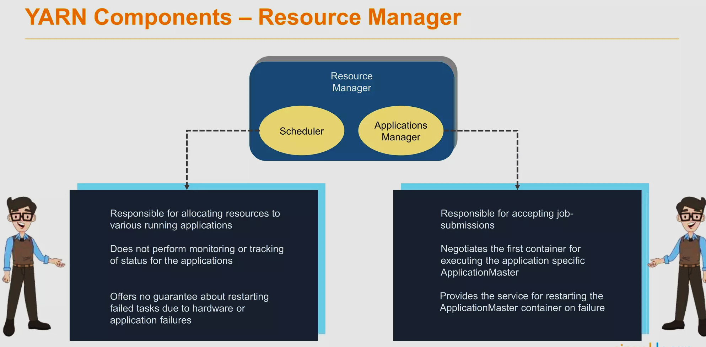

Slide 40
Resource Manager has two components:
Scheduler: Schedulers’ task is to distribute resources to the running applications. It only deals with the scheduling of tasks and hence it performs no tracking and no monitoring of applications.
Application Manager: The application Manager manages applications running in the cluster. Tasks, such as the starting of Application Master or monitoring, are done by the Application Manager.

Slide 41
Schedulers
The scheduler is responsible for allocating resources to the various running applications subject to constraints of capacities, queues etc.
It is called a pure scheduler in ResourceManager, which means that it does not perform any monitoring or tracking of status for the applications.
If there is an application failure or hardware failure, the Scheduler does not guarantee to restart the failed tasks.
Performs scheduling based on the resource requirements of the applications.
It has a pluggable policy plug-in, which is responsible for partitioning the cluster resources among the various applications. There are two such plug-ins: Capacity Scheduler and Fair Scheduler, which are currently used as Schedulers in ResourceManager.

Slide 42
There are three types of scheduling policies available in YARN:
FIFO Scheduler: It is a simple scheduler that follows a first-come, first-served approach and it’s suitable for smaller clusters and simple workloads.
Capacity Scheduler: It is a scheduler that divides cluster resources into multiple queues, each with its own reserved resources while able to dynamically utilize unused resources from other queues. It is suitable for large-scale, multi-user environments.
Fair Scheduler: It is a scheduler that is designed to balance resources fairly and equally among accepted jobs, without requiring a set amount of reserved capacity. It is suitable for the cluster that runs jobs with varying sizes and resource requirements.

Slide 43
Application Manager
The ApplicationManager is an interface that maintains a list of applications that are submitted, running, or completed. It is responsible for:
Handling job submission: Accepting job submissions to YARN,
Negotiating resources for the ApplicationMaster: Negotiating the first container for executing the application-specific application master, and
Managing failover of the ApplicationMaster: Restarting the application master container on failure.

Slide 44
Application Master (AM)
The ApplicationMaster is a process that runs the main function/entry point of an application, such as the Spark driver. It has several responsibilities, including:
Requesting resources: Negotiating with the Resource Manager to obtain resources for launching containers to execute tasks.
Running the Master/Driver program: It runs the Master/Driver program, such as Spark Driver, which devises the job execution plan, assigns tasks in the allocated containers, tracks task execution status, monitors progress, and handles task failures.

Slide 45
Node Manager (NM)
NodeManagers are Java processes that run on slave/worker nodes in a Hadoop cluster. They are responsible for managing containers and resources on each worker node, providing a secure runtime environment for applications, and allowing for efficient and flexible resource allocation.

Slide 46
Reporting node health: Each Node Manager announces itself to the ResourceManager and periodically sends a heartbeat to provide node status and information, including memory and virtual cores. In case of failure, the Node Manager reports any issues to the Resource Manager, diverting resource allocations to healthy nodes.
Launching Containers: Node Managers take instructions from the ResourceManager, launch containers on their nodes, and set up the container environment with the specified resource constraints.
Container Management: Node Managers manage container life cycle, dependencies, leases, resource usage, and log management.

Slide 47
ResourceManager: The ResourceManager in YARN is responsible for allocating containers to Application Masters based on their resource requests. It provides the container launch context (CLC) that includes environment variables, dependencies, security tokens, and commands to create the application's launch process.
NodeManager: The NodeManager in YARN is responsible for launching the containers with specified resource constraints (CLC).
ApplicationMasters: The Application Masters manage the execution of tasks within these containers, monitor their progress, and handle any task failures or reassignments.

Slide 48
Node Manager
Node Manager is the slave daemon of YARN. It has the following responsibilities:
Node Manager has to monitor the container’s resource usage, along with reporting it to the Resource Manager.
The health of the node on which YARN is running is tracked by the Node Manager.
It takes care of each node in the cluster while managing the workflow, along with user jobs on a particular node.
It keeps the data in the Resource Manager updated
Node Manager can also destroy or kill the container if it gets an order from the Resource Manager to do so.

Slide 49
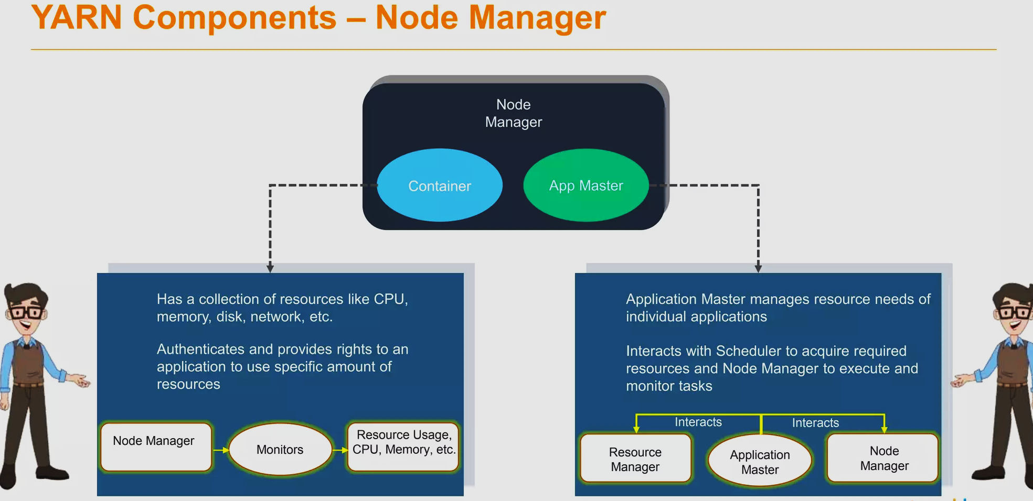

Slide 50
Application Master
Every job submitted to the framework is an application, and every application has a specific Application Master associated with it. Application Master performs the following tasks:
It coordinates the execution of the application in the cluster, along with managing the faults.
It negotiates resources from the Resource Manager.
It works with the Node Manager for executing and monitoring other components’ tasks.
At regular intervals, heartbeats are sent to the Resource Manager for checking its health, along with updating records according to its resource demands.

Slide 51
Container
A container is a set of physical resources (CPU cores, RAM, disks, etc.) on a single node. The tasks of a container are listed below:
It grants the right to an application to use a specific amount of resources (memory, CPU, etc.) on a specific host.
YARN containers are particularly managed by a Container Launch context which is Container Life Cycle (CLC). This record contains a map of environment variables, dependencies stored in remotely accessible storage, security tokens, the payload for Node Manager services, and the command necessary to create the process.

Slide 52
Applications on YARN
Hadoop YARN cluster runs various work-loads. This means a single Hadoop cluster in your data center can run MapReduce, Storm, Spark, Impala, and more.

Slide 53
Running an Application through YARN
Broadly, there are five steps involved in YARN to run an application:
The client submits an application to the Resource Manager
The ResourceManager allocates a container
The Application Master contacts the related Node Manager
The Node Manager launches the container
The container executes the Application Master

Slide 54
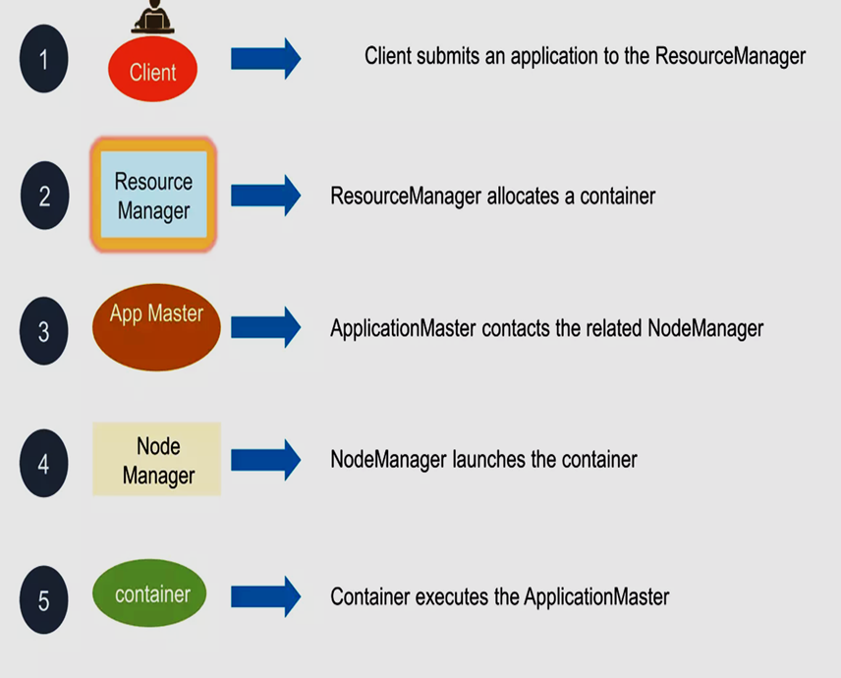

Slide 55
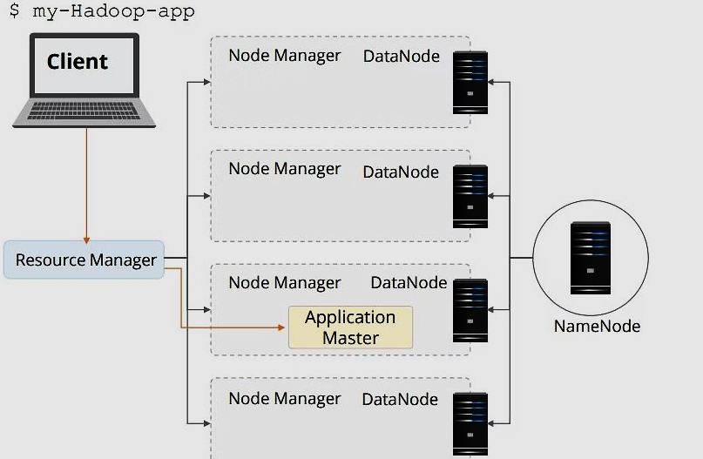
Step 1 - Application submitted to the Resource Manager
Users submit applications to the Resource Manager by typing the Hadoop jar command.

Slide 56
The Resource Manager maintains the list of applications on the cluster and available resources on the Node Manager. The Resource Manager determines the next application that receives a portion of the cluster resource. The decision is subject to many constraints such as queue capacity, Access Control Lists, and fairness.

Slide 57
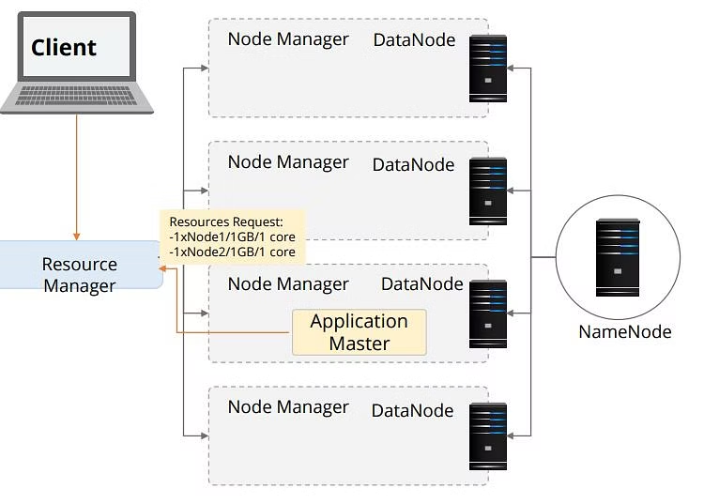
Step 2 - Resource Manager allocates Container
When the Resource Manager accepts a new application submission, one of the first decisions the Scheduler makes is selecting a container. Then, the Application Master is started and is responsible for the entire life-cycle of that particular application.

Slide 58
First, it sends resource requests to the ResourceManager to ask for containers to run the application's tasks.
A resource request is simply a request for a number of containers that satisfy resource requirements such as the following:
Amount of resources expressed as megabytes of memory and CPU shares Preferred location, specified by hostname or rackname, Priority within this application and not across multiple applications.
The Resource Manager allocates a container by providing a container ID and a hostname, which satisfies the requirements of the Application Master.

Slide 59
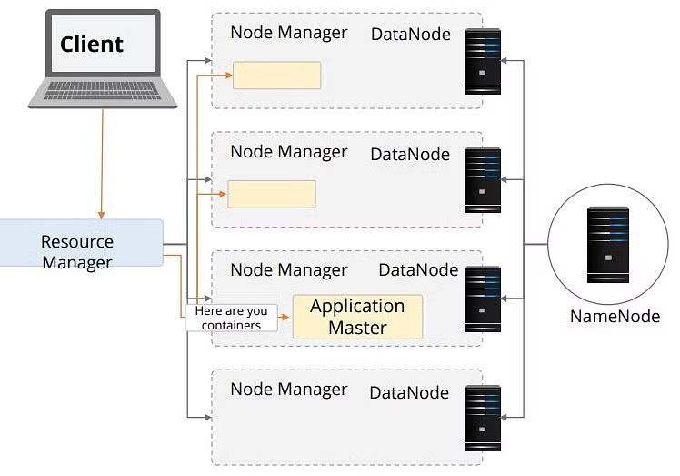
Step 3 - Application Master contacts Node Manager

Slide 60
After a container is allocated, the Application Master asks the Node Manager managing the host on which the container was allocated to use these resources to launch an application-specific task. This task can be any process written in any framework, such as a MapReduce task.

Slide 61
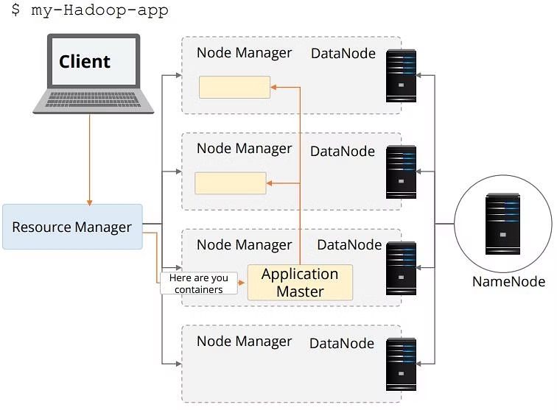
Step 4 -Resource Manager Launches Container

Slide 62
The NodeManager does not monitor tasks; it only monitors the resource usage in the containers.
For example, it kills a container if it consumes more memory than initially allocated.
Throughout its life, the Application Master negotiates containers to launch all of the tasks needed to complete its application. It also monitors the progress of an application and its tasks, restarts failed tasks in newly requested containers, and reports progress back to the client that submitted the application.

Slide 63
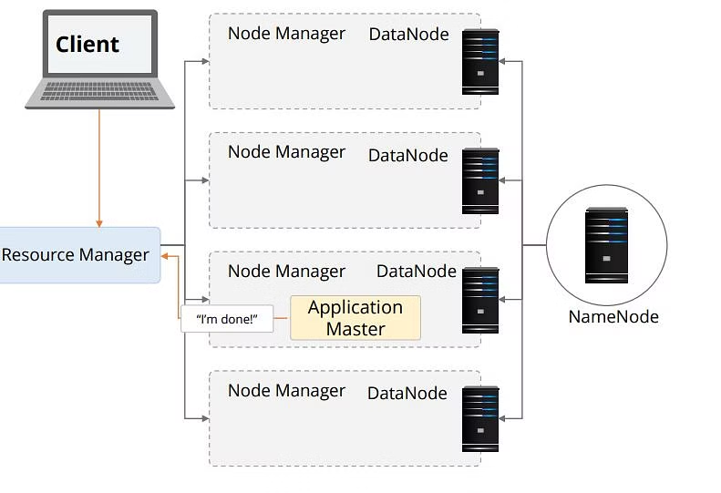
Step 5 - Container Executes the Application Master

Slide 64
After the application is complete, the Application Master shuts itself and releases its own container. Though the ResourceManager does not monitor the tasks within an application, it checks the health of the ApplicationMaster. If the ApplicationMaster fails, it can be restarted by the ResourceManager in a new container. Thus, the resource manager looks after the ApplicationMaster, while the ApplicationMaster looks after the tasks.

Slide 65
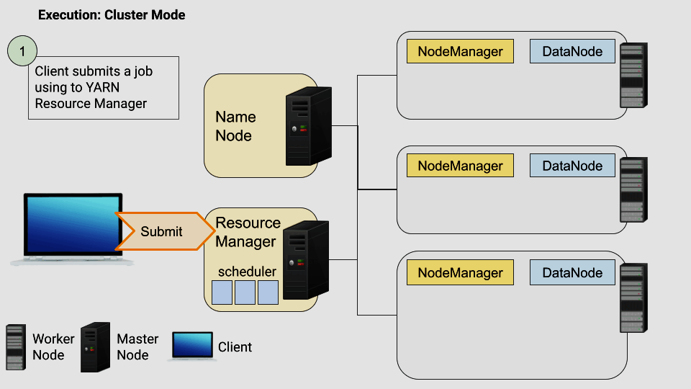
How Applications run on YARN
Spark application as an example to illustrate how YARN handles job requests, allocates resources, and manages components such as the ApplicationMaster and NodeManager.

Slide 66
Step 1: A client submits a job using “spark-submit” to the YARN Resource Manager.
Step 2: The job enters a scheduler queue in the ResourceManager, waiting to be executed.
Step 3: When it is time for the job to be executed, the ResourceManager finds a NodeManager capable of launching a container to run the ApplicationMaster.
Step 4: The ApplicationMaster launches the Driver Program (the entry point of the program that creates the SparkSession/SparkContext).

Slide 67
Step 5: The ApplicationMaster/Spark calculates the required resources (CPU, RAM, number of executors) for the job and sends a request to the Resource Manager to launch the executors.
> The ApplicationMaster communicates with the NameNode to determine the file (block) locations within the cluster using the HDFS protocol.
Step 6: The Driver Program assigns tasks to the executor containers and keeps track of the task status.
Step 7: The executor containers execute the tasks and return the results to the Driver Program. The Driver Program aggregates the results and produces the final output.

